Slide 1



AutoScope
Early detection of ear infections app
Alon Ternerider & Nadav Goldin
Supervised by Dr. Nataly Levi

Slide 2
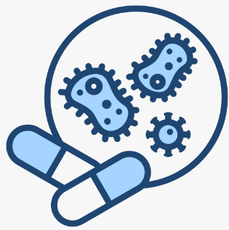

Ear Infections otitis media
Occur when fluid builds up behind the eardrum,
leading to inflammation and pain.
Can lead to complications such as hearing loss or the spread of infection to nearby tissues.
When caught early, treatment with ear drops may be enough. If not detected in time, more intense treatment (like antibiotics) is required.

Slide 3
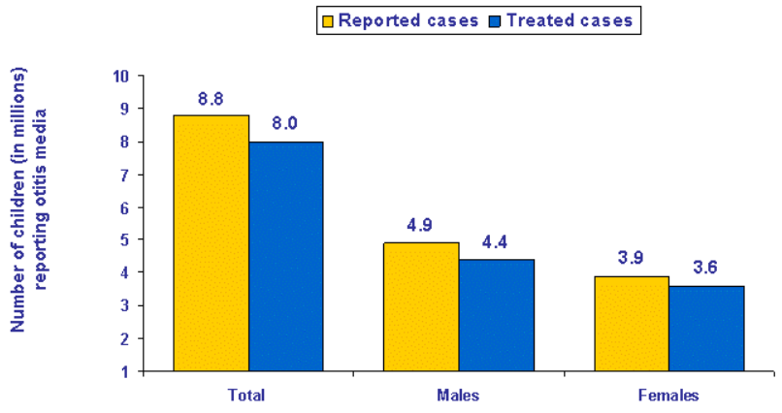
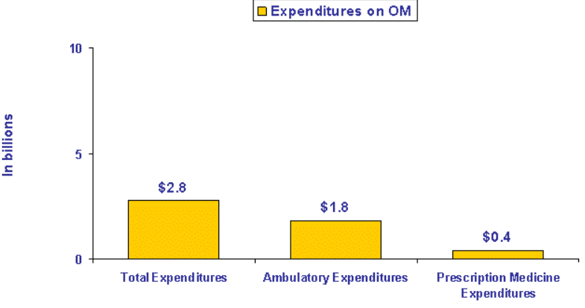
Statistics
Notes:
n 2006, 8.8 million (11.8 percent) of U.S. children under age 18 reported to have ear infections or otitis media
A total of $2.8 billion was spent on treatment of otitis media (not including over-the-counter medications) (figure 2). A higher percentage of these expenditures was spent on ambulatory visits compared to prescription medications ($1.8 billion versus $.4 billion).

Slide 4

Early Symptoms
How It Feels ?
How It Looks ?
Ear pain (especially when lying down)
Trouble hearing
Irritability or fussiness in children
Trouble sleeping
Redness or inflammation
Bulging eardrum
Cloudiness of the eardrum
Fluid or bubbles behind the eardrum

Slide 5
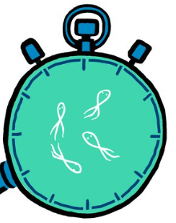
Motivation Why early detection matters ?
Treat the infection with ear drops instead of antibiotics – which has significant impact, especially in children.
Saves time for both patients and healthcare professionals.
Reduce the overall medical cost.

Slide 6
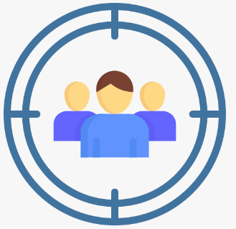
Who will benefit from AutoScope ?
The users of AutoScope will be adults and doctors
Beneficiaries of AutoScope:
Children
Prevent severe complications and reduce antibiotic usage
Parents
Monitoring ear health from home, reducing costs and time of doctor dependency.
Doctors
Optimize medical resources, decision support tool
Public Health System
Optimization of resources

Slide 7

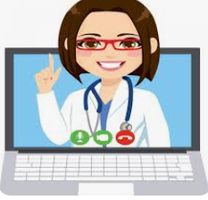
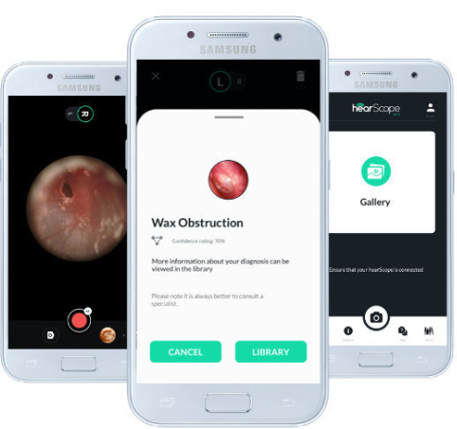
Existing methods
Traditional Otoscope
Handheld device used by healthcare professionals for inspection
Dependent on Doctor’s expertise, timing and costs of physical meeting
Telemedicine Solutions
Consulting healthcare professionals remotely, using digital otoscope
Dependent on Doctor’s expertise, timing and costs of physical meeting
Mobile Apps integrated with digital otoscope
Capture high-resolution images and analyze them in mobile app
Mostly provides educational resources and symptom analysis
Lack sophisticated diagnostic ability.

Slide 8





Our Solution
Advanced mobile app that integrates deep learning models with an otoscope, providing accurate and real-time detection of early and late ear infection symptoms.
Automated
Diagnosis
Real-Time results
User Friendly interface
Cost-Effective

Slide 9


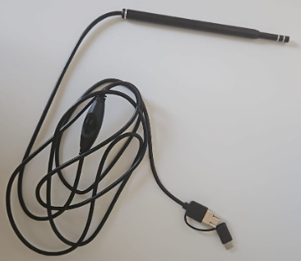

Proposed Architecture (Client)
PyInstaller
GUI
Kivy
Hardware Connectivity
PyUSB Library

Slide 10




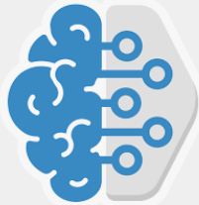
Proposed Architecture (Server)
Model Training
Deep Learning Model
TensorFlow Library
DataSet
Application Logic
Flask
Trained Model

Slide 11
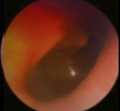

Proposed Architecture (Connectivity)
REST API
Model Prediction

Slide 12
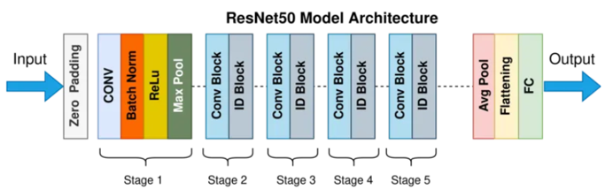
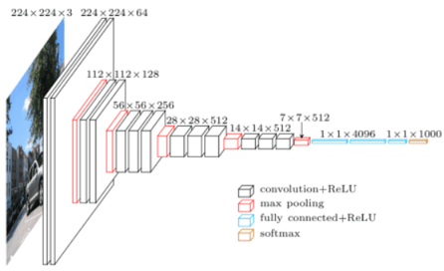
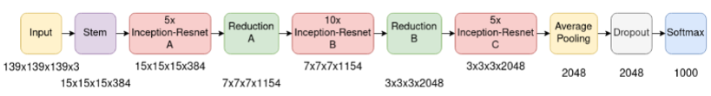
Proposed Model Architecture
Proposed Model Architecture
VGG16
50-layer Deep convolutional network
Uses convolutional and identity blocks for features extraction
Skip connections to avoid vanishing gradient problem
Focus on sublet patterns of eardrum to detect infection
Uses small convolutional filters (3*3)
Down-sample images using max-pooling
Classify eardrum state using fully connected layers and softmax
InceptionResNetV2
Combine inception modules with residual connections
Efficiently captures multi-scale features of eardrums
Focus both fine and large details

Slide 13
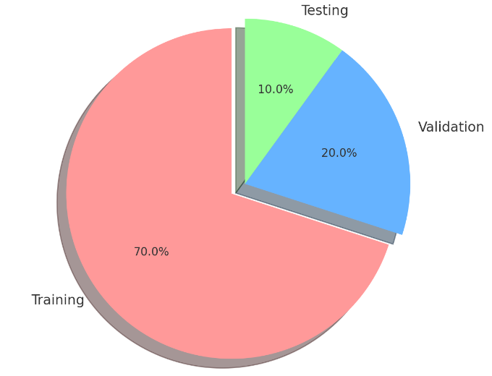
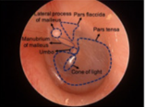
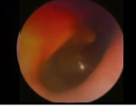
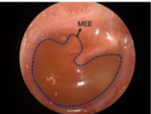
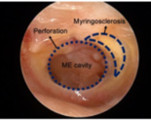
DataSet
We will use public datasets (~1000 images)
Data will be labeled – learning process is supervised
Data should be labeled with main OM types not only as “normal” or “infected”
Preprocess (Resizing & Normalizing(
Normal
AOM
OME
COM

Slide 14
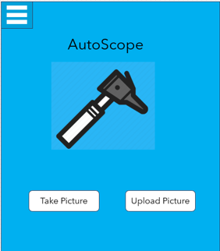
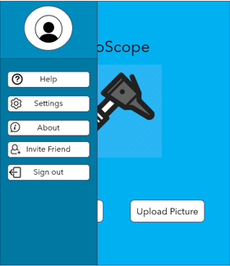
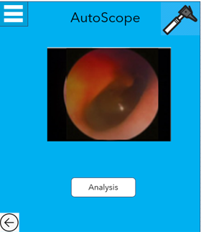
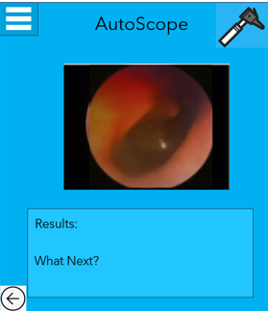
App Interface

Slide 15
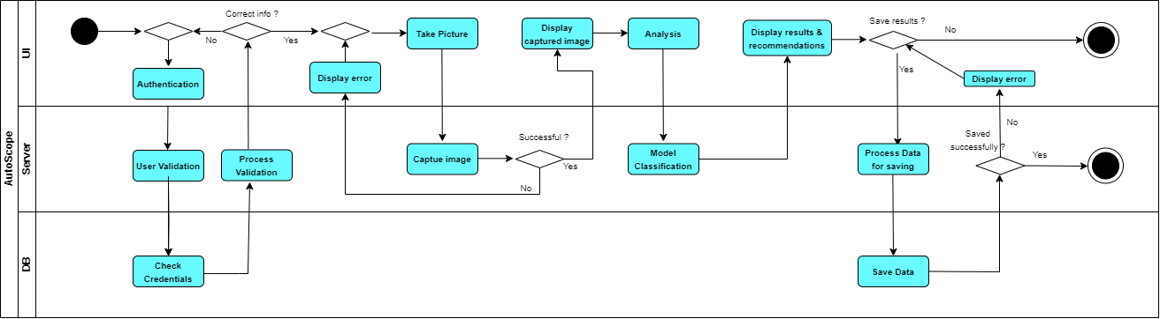
Activity Diagram (Analysis of captured image)

Slide 16




Expected results
Accurate Early Detection
Efficiently detect early ear infection using the model
Accessibility
Very simple otoscope and mobile will be enough
Cost & Time Savings
Saving time and money in doctors visits and purchasing antibiotics
Resource Optimization
Doctors can optimize their time better (less patients), and use the app as well
Healthier immune System (Long term result)
By reducing the usage of antibiotics, our bodies will become more resilient and less reliant on antibiotics.

Slide 17


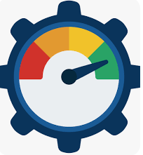

How success will be measured ?
Accuracy Rate > 80%
Based on Testing part of the dataset
User Satisfaction
Collect feedback using surveys and ratings
Monitor time & money saved by users
App Performance
Response time, stability and testing
Resource Optimization
How have time and resources of doctors changed ?

Slide 18


Expected challenges
Integration of Components
Successfully connect all parts, Ensure smooth communication between server-side processing and client-side interaction.
Data Privacy
Protect sensitive medical data.
User Adoption
Encourage users to trust the app’s diagnosis by building confidence through education and user-friendly experiences.
Achieve Required Accuracy
wrong prediction should favor over-diagnosing rather than under-diagnosing to avoid missing dangerous cases.
Notes:
Achieve Required Accuracy: Ensure the model prioritizes minimizing false negatives so that no severe ear infections are missed. A wrong prediction should favor over-diagnosing rather than under-diagnosing to catch all potential cases.
Integration of Components: Successfully connect all parts, from training the model on the cloud, hosting it on the server, to deploying it on the client app. Ensure smooth communication between server-side processing and client-side interaction.
Data Privacy: Protect sensitive medical data through encryption and comply with privacy regulations (e.g., GDPR).
User Adoption: Encourage users to trust the app’s diagnosis by building confidence through education and user-friendly experiences.

Slide 19
